Slide 1
IT1102
Computer Hardware
Week 5
Installation and Configuration of Driver Software

Slide 2
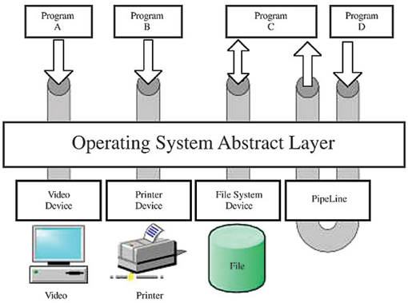
Device Drivers
System software support application software
Provide interface to Hardware devices
  Computer program allowing higher-level computer programs to interact with a hardware device

Slide 3
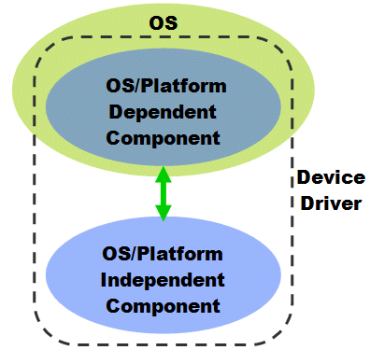
Device Driver
  Drivers are hardware dependent
  Operating system specific

Slide 4
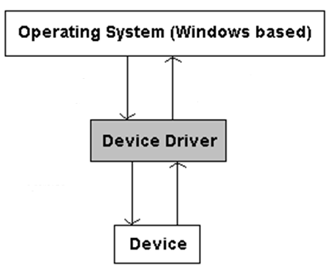
Device Drivers
  Calling program invokes a routine in the driver
  Driver issues commands to the device
  Device sends data back to the driver
  driver may invoke routines in the calling program

Slide 5
Device Drivers
How to get
  Built into the product (Firmware)
  Include with operating system (plug and play)
  Comes with driver CD provided by vender
  Download from internet or vendor web site
Important
  After installing some device drivers computer may need to restart
    To read the device drivers in to primary memory

Slide 6
Device Manager
System tool (software included to OS)
In Microsoft Windows operating systems
Allows users to view and control hardware
Include facilities for view
  List of Devices in computer
  Associated device drivers of HW devices
  Devices by type

Slide 7
Device Manager
Change hardware configuration settings.
Obtain information about each device driver.
Install & updated device drivers.
Disable, enable, and uninstall devices.
Reinstall the previous version of a driver.
Identify device conflicts and manually configure resource settings.
Print a summary of the devices that are installed on your computer.

Slide 8
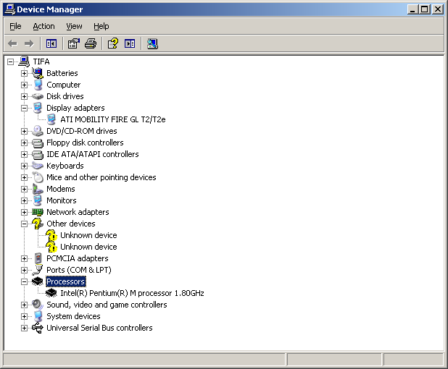
Device Manager

Slide 9
Device Manager
Windows XP
  Control panel -> System-> hardware tab - Device Manager
Windows Vista
  Control Panel -> Device Manager
Windows 7
  Control Panel -> Device Manager

Slide 10
Plug and Play (PnP)
Also known as hot plugging/ hot swapping
Technology to automatically detect the attached HW in a computer system with minimum user intervention
  Automatically detection is a capability of a computer bus
  It facilitates the discovery of a hardware in a system

Slide 11
Plug and Play devices
PS2 mouse or key board
All USB using devices

